Slide 1

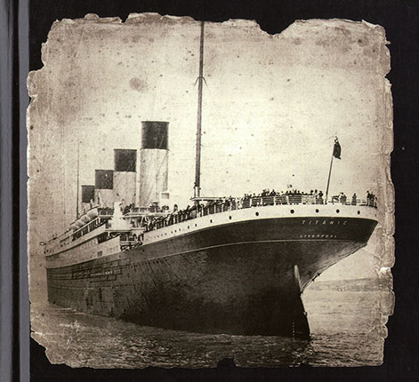
TITANIC
Sail into the data
Presented by:
Roi Koresh

Slide 2
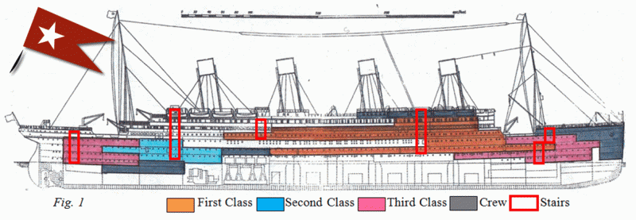
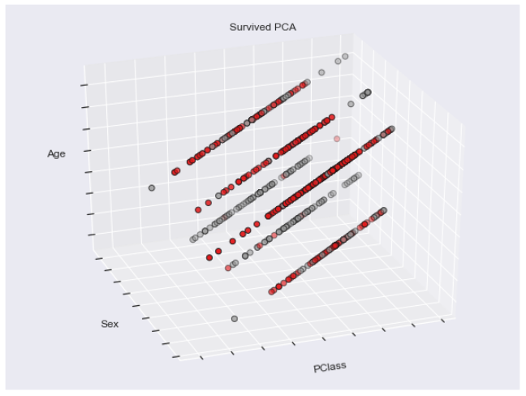
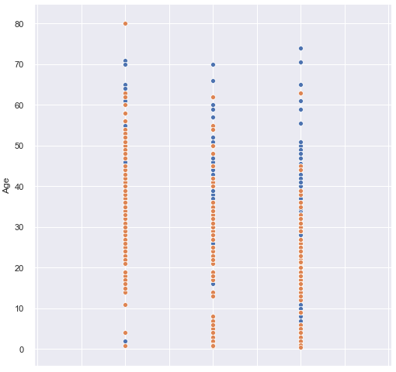
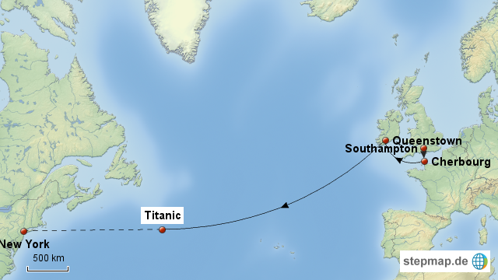
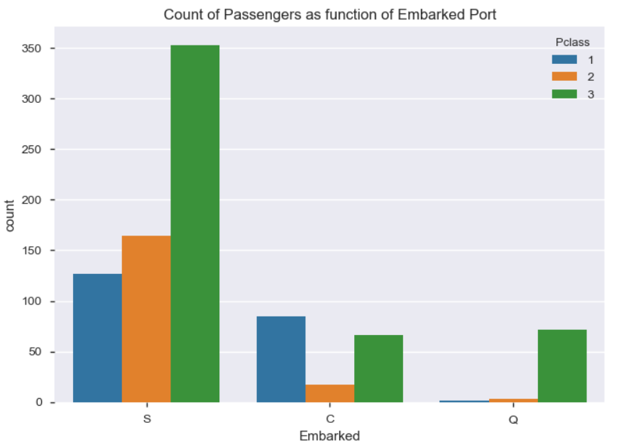
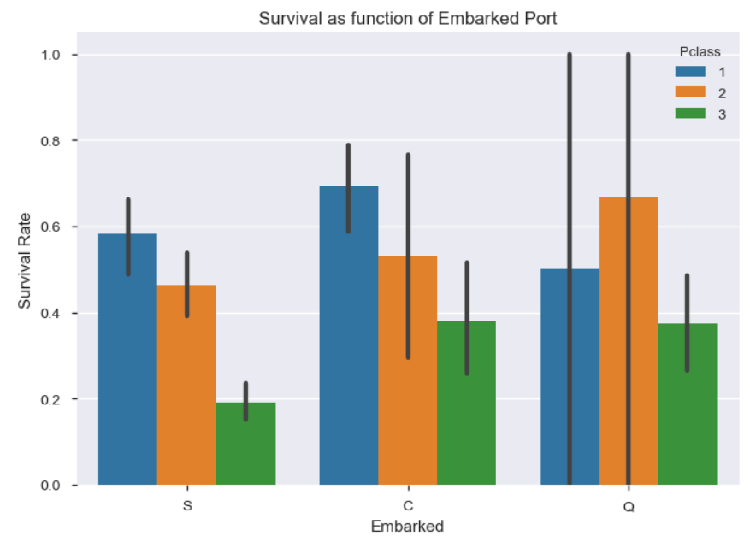

PASSNGERS
Total Passengers: 1,309
PClass
Embarked – PClass – Survived
Queenstown
77
Embarked locations
Cherbourg
168
Southampton
644
342
284
709

Slide 3
Preparing the data – Prep the data
Missing values
Adding Features
Filling values
Cabin
Train Dataset - 77% missing values.
Age
Train Dataset - 19.8% missing values.
Embarked
Train Dataset - 0.02% missing values.
Train Dataset - 0 missing values.
Fare
Test Dataset - 78% missing values.
Test Dataset - 20.57% missing values.
Test Dataset - 0 missing values.
Test Dataset - 0.24% missing values.
more than 75% of missing values - remove the Cabin
High Correlation
Parch
SibSp
New Feature
FamilySize
Extract
Families
Is Alone
Tried to use median but seems it isn’t good enough.
New approach:
Median Age of Pclass.
Medan Age of Male & Female
Most common occurrence - S
Median

Slide 4
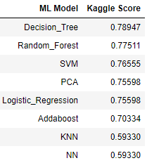
Machine learning - Models
Decision Tree Classifier
Pclass, Fare, Title
Random Forest Classifier
Sex, Age, Ticket, Fare, Embarked, Title, FamilySize, IsAlone
Addaboost
Age, Ticket, Fare, Title
SVM
Pclass, Sex, Age, Ticket, Fare, Embarked, Title, FamilySize, IsAlone
KNN
Sex, Fare, Title, FamilySize
Neural Nets
Pclass, Sex, Age, Ticket, Fare, Embarked, Title, FamilySize, IsAlone
PCA
Pclass, Sex, Age, Ticket, Fare, Embarked, Title, FamilySize, IsAlone
Logistic Regression
Pclass, Sex, Ticket, Fare, FamilySize
How we going to do it?
Check best features to each model
Fit each model with his best features.
Split TRAIN dataset to 70% train and 30% test = better results
Optimization -
Each model we will save the best accuracy and the Kaggle accuracy

Slide 5
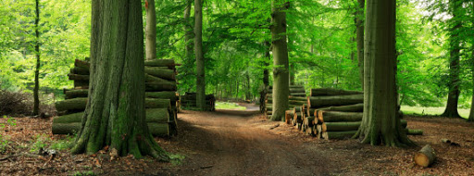
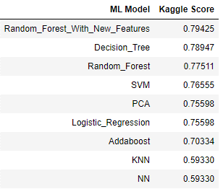
Best model – Random Forest
score: 80.9 | after improve: 81.7 | Kaggle: 79.4
What we did?
Used Unsupervised clustering to improve the results (Hierarchical Clustering) – FamilySize vs. Survived
Checked the Female in cluster 0 (FamilySize > 1) → Mother have survival instincts
We saw when a famiky have a Mother in it they had more chance to life.
Create new feature – “Mother”
Checked the new feature correlation with others
Fit the Random Forest model
Scored better accuracy

Slide 6
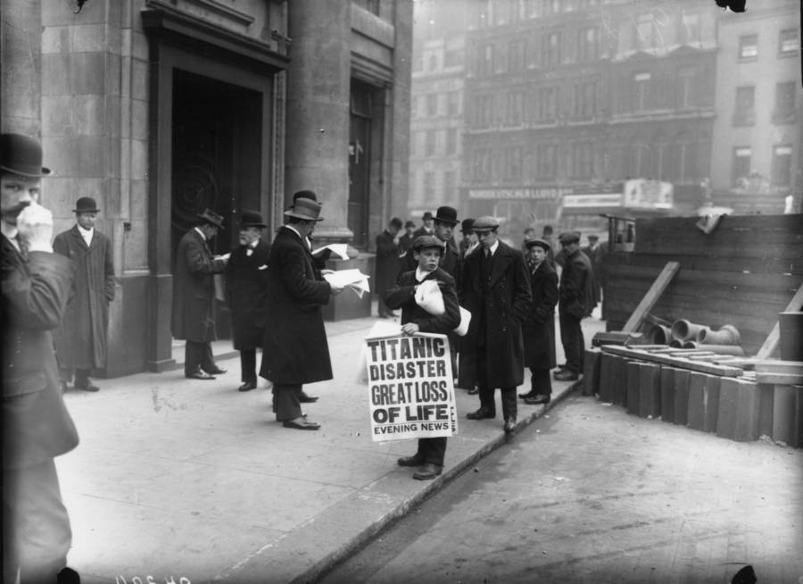
Questions?

